Slide 1
Experimental scientists make a fudemental distinction between three types of error. These are known as gross, random, and systematic errors.
Example: Four students (A-D) each performed an analysis in which exactly 10.00ml of exactly 0.1M sodium hydroxide is tritrated with exactly 0.1M hydrochloric acid. Each student performed five replicate tritrations.
    Student Results (ml)
    A 10.08 10.11 10.09 10.10 10.12
    B 9.88 10.14 10.02 9.80 10.21
    C 10.19 9.79 9.69 10.05 9.78
    D 10.04 9.98 10.02 9.97 10.04

Slide 2
Correct Result
*****
---+---------+---------+---------+---------+---------+---Student A
* * * * *
---+---------+---------+---------+---------+---------+---Student B
* ** * *
---+---------+---------+---------+---------+---------+---Student C
*
** * *
---+---------+---------+---------+---------+---------+---Student D
9.70 9.80 9.90 10.00 10.10 10.20
Titrate Volume, ml

Slide 3
Statisticians say that random errors affect the precision of an experiment, i.e. spread in the observed data.
Systematic errors, also called bias, affect accuracy, i.e. proximity to the true value.
Systematic errors (bias / accuracy)
tends to give results that are always higher or lower than the true value. These could arise, for example, from someone who is unable to judge a shape colour change in visual titrations, resulting in a slight over-reading of the end-point.
Random errors (reproducability / precision)
which arise from the individual results falling on both sides of the true response. These errors are the slight variations that occur when successive measurements are made by the same person under nearly identical conditions as possible.

Slide 4
Student Comment
A Precise but Inaccurate!
B Accurate but Imprecise!
C Inaccurate and Imprecise!!
D Accurate and Precise.
Recap: In everyday English the words accuracy and precision are interchangable. In analytical chemistry however these terms are used to refer to two entirely distinct types of errors.

Slide 6
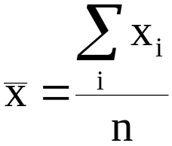
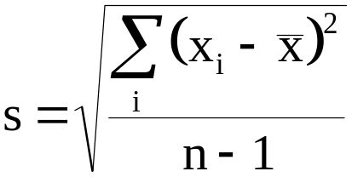
MEAN AND STANDARD DEVIATION.
Consider again the results of five replicate tritrations done by each of the four students. Two criteria were used to compare these results, the average value and the degree of spread. The average value used was the sample mean:
The most useful measure of spread is the sample standard deviation, s. This is defined by the formula:

Slide 7

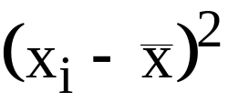

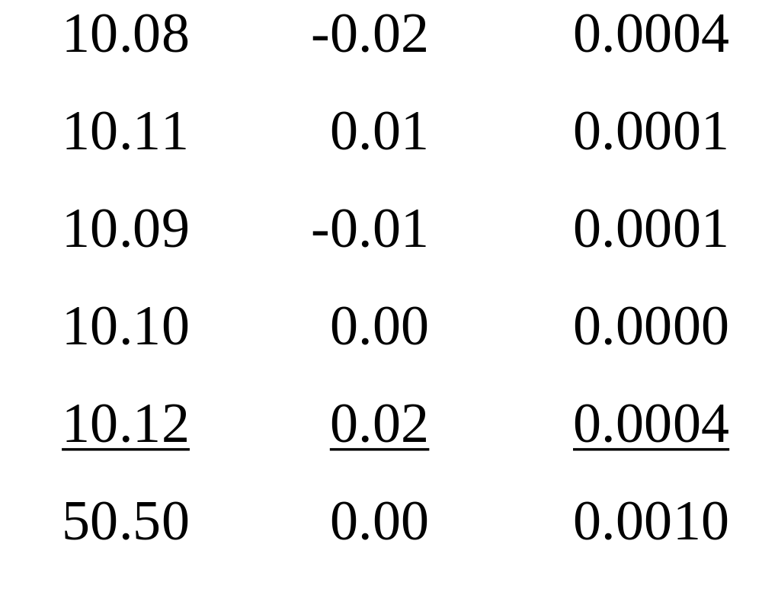
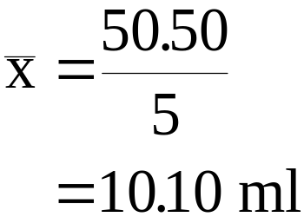
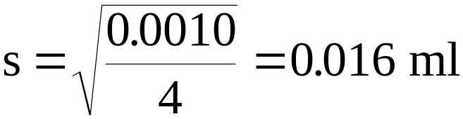
Totals =

Slide 8
Student Mean SD Accurate Precise
A 10.10 0.01 No Yes
B 10.01 0.17 Yes No
C 9.90 0.21 No No
D 10.01 0.03 Yes Yes

Slide 9

The square of s is a very important statistical quantity known as the variance; its value will become apparent later when we consider the propagation of errors.
Also widely used is the coefficient of variation (CV), also known as the relative standard deviation (RSD), and is given by
The CV or RSD, the units of which are obviously per cent, is an example of relative error. Relative errors are frequently used in the comparison of the precision of results which have different units or magnitudes, and are again important in the calculation of error propagation.

Slide 10
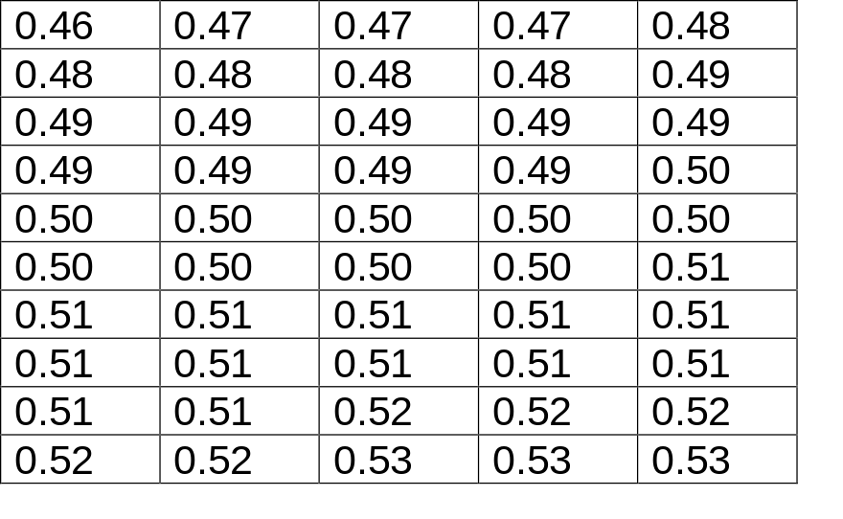
Example: The data below are the results of 50 replicate determinations of nitrate ion concentration in a particular water specimen, given to two significant figures. The data have been ordered low to high.
Nitrate Ion
Conc μg/ml Frequency
    0.46 1
    0.47 3
    0.48 5
    0.49 10
    0.50 10
    0.51 13
    0.52 5
    0.53 3

Slide 11
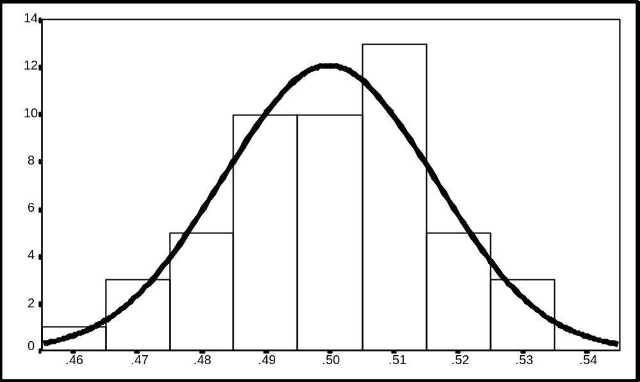
notice the characteristic bell shape of the histogram
measurement errors follow a normal or ‘Gaussian’ distribution
the data vary, but in a limited way
much naturally occurring data follow a normal distribution
many statistical techniques we will develop in later lectures require the assumption of normality in the data being analysed
we could write a mathematical expression for this curve

Slide 12
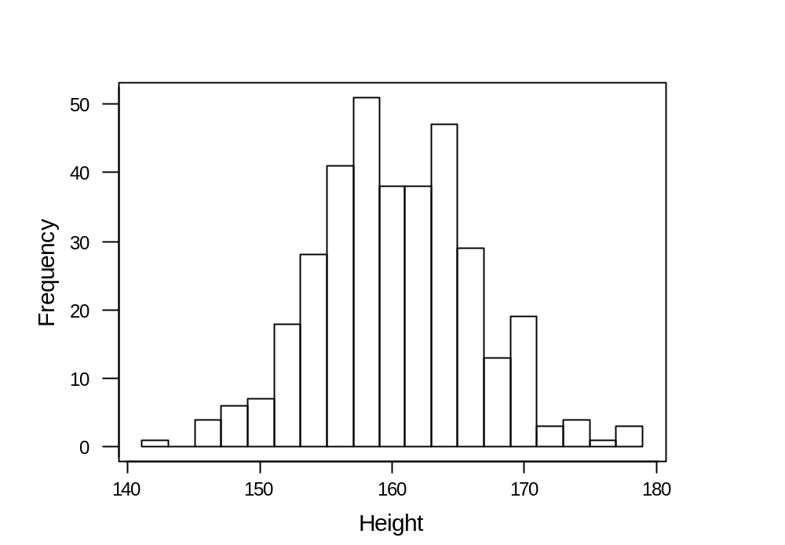
Example: heights in centimeters of a sample of 351 elderly women randomly selected in a study of osteoporosis.

Slide 13
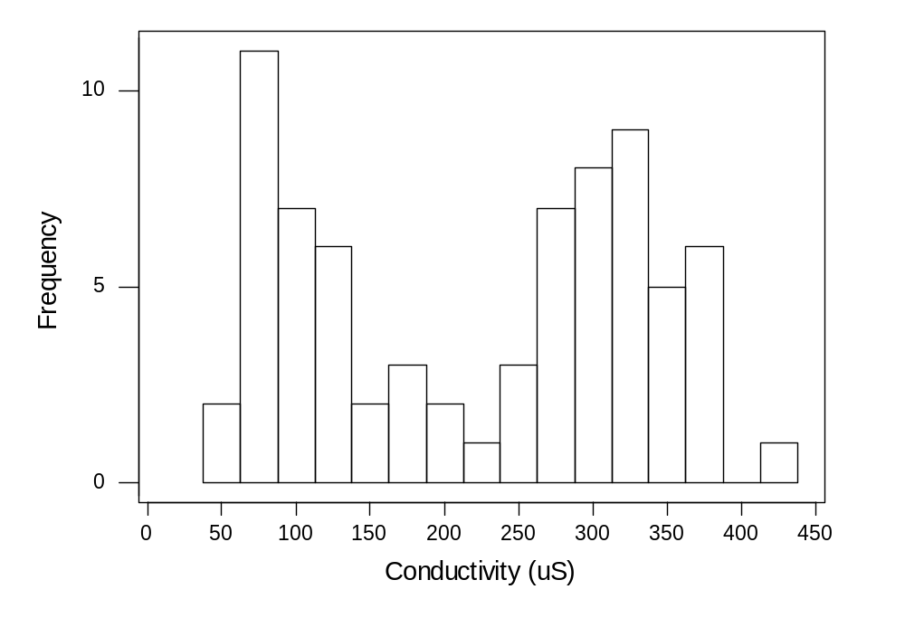
Example: Conductivity readings for 73 soil samples taken from a grassland patch in the Burren Co. Clare.

Slide 14
Characteristic Shapes of Histograms
Bell-shaped
symmetric Bimodal Trimodal
+’ve skewed -’ve skewed Symmetric
+’ve J shaped -’ve J shaped Uniform

Slide 15





Common Transformations To Reduce Skewness
DEGREE OF SKEWNESS TRANSFORMATION
+’ve, low Square root
+’ve , medium Logarithmic
+’ve , high Reciprocal
-’ve , low Square
-’ve , high Cubic

Slide 16
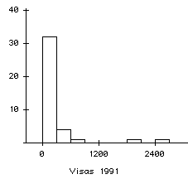
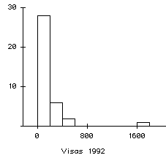
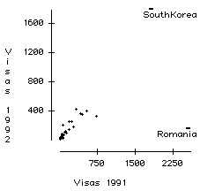
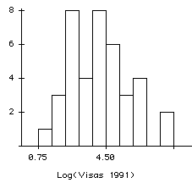
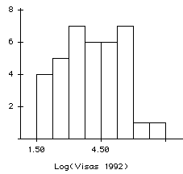
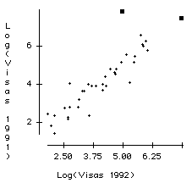
Example: Consider data on the number of U.S. visa issued for the purposes of adoption by U.S. residents, years 1991 and 1992.

Slide 17
Boxplots: Boxplots display 6 features of a data set….
1. Lower Quartile
25% of measurements in the data set are below this value
2. Median
50% of measurements in the data set are below this value
3. Upper Quartile
75% of measurements in the data set are below this value
4. The Inter Quartile Range, IQR = Q_{upper} -Q_{lower}
50% of measurements in the data set lie between these values
5. Bottom and Upper Whiskers
1.5 times (median-Q_{lower}) & (Q_{upper}-median) respectively
6. Outlying Observations
Values beyond the whiskers
+ a scale for the data

Slide 18
Example: In 1798, Henry Cavendish estimated the density of the Earth by using a torsion balance. His 29 measurements of Earth’s density are presented as a multiple of the density of water.
5.50, 5.57, 5.42, 5.61, 5.53, 5.47, 4.88, 5.62, 5.63, 4.07, 5.29, 5.34, 5.26, 5.46, 5.44 5.55, 5.34, 5.30, 5.36, 5.79, 5.75, 5.29, 5.10, 5.86, 5.58, 5.27, 5.85, 5.65, 5.39.
First step is to order the data from low to high:
4.07, 4.88, 5.10, 5.26, 5.27, 5.29, 5.29, 5.30, 5.34, 5.34, 5.36, 5.39, 5.42, 5.44, 5.46 5.47, 5.50, 5.53, 5.55, 5.57, 5.58, 5.61, 5.62, 5.63, 5.65, 5.75, 5.79, 5.85, 5.86.
    Median 5.460
    Q lower 5.295
    Q upper 5.615
    W lower 1.5 x (5.46-5.295) = .2475
    W upper 1.5 x (5.615-5.46) = .2325

Slide 19
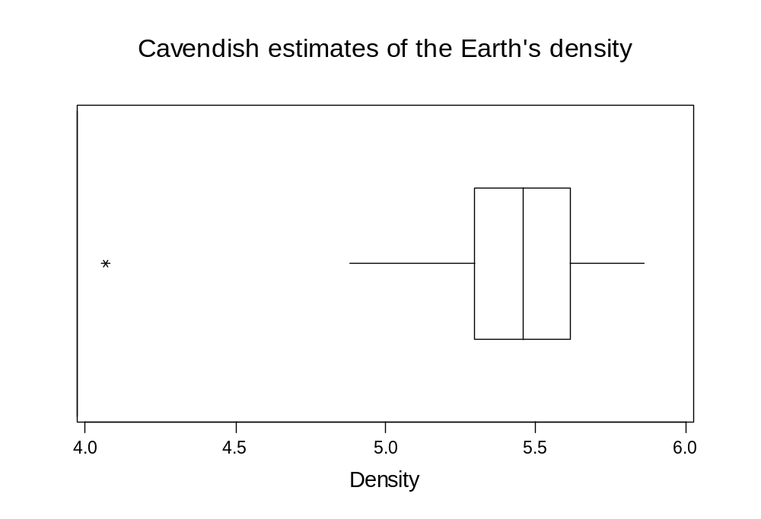
The median falls half way between Q-lower and Q-upper and the whiskers are approximately the same length. Together these two facts suggest the data have a symmetric distribution.

Slide 20
Draw the Boxplot for each of
Symmetric +’ve skewed -’ve skewed
distribution distribution distribution

Slide 21
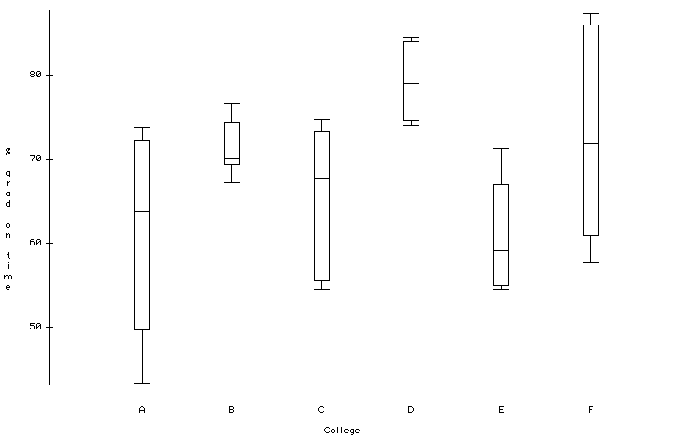
Example : Percentage of Entering Class Graduating on Time.
A large University reports the percentage of the entering Freshman class graduating “on time” in each of 6 separate colleges making up the University.

Slide 22
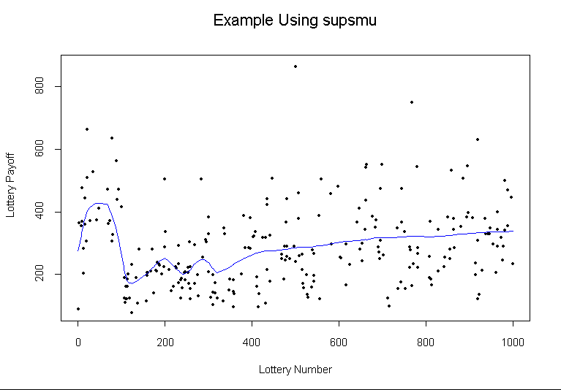

Slide 23
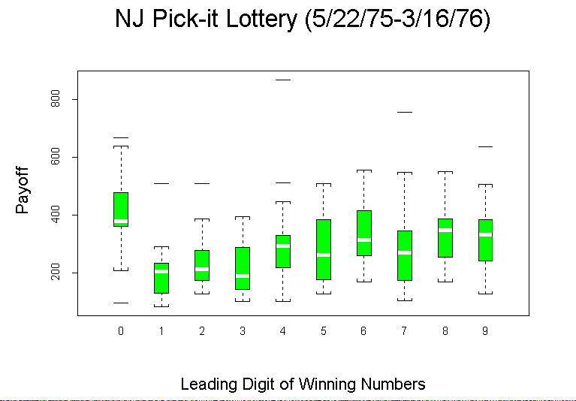

Slide 24
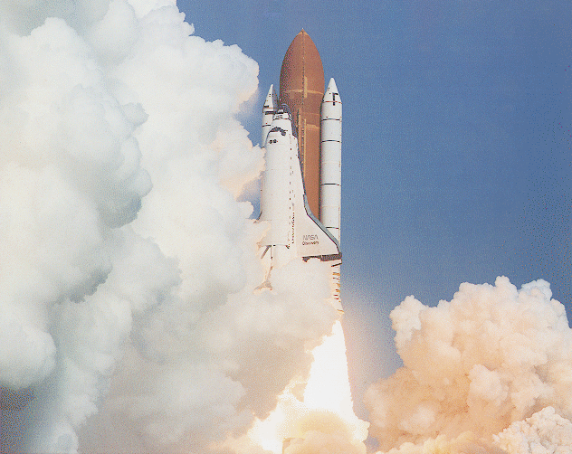
The Flight of the Space Shuttle Challenger

Slide 25
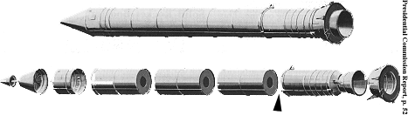
Each boaster rocket consists of several pieces whose joints are sealed with rubber O-rings, which are designed to prevent the the release of hot gasses. Each booster contains 3 primary O-rings (a total of 6 per craft).
Position of faulty O-ring determined as the cause of the Challenger disaster

Slide 26
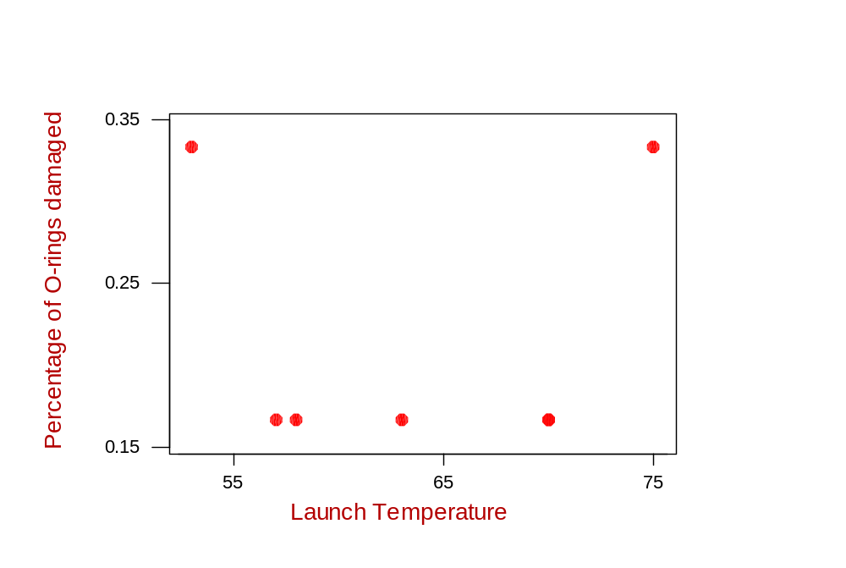
There is no obvious relationship between O-ring damage and launch temperature.
Can you spot the serious flaw in the engineers’ method??

Slide 27
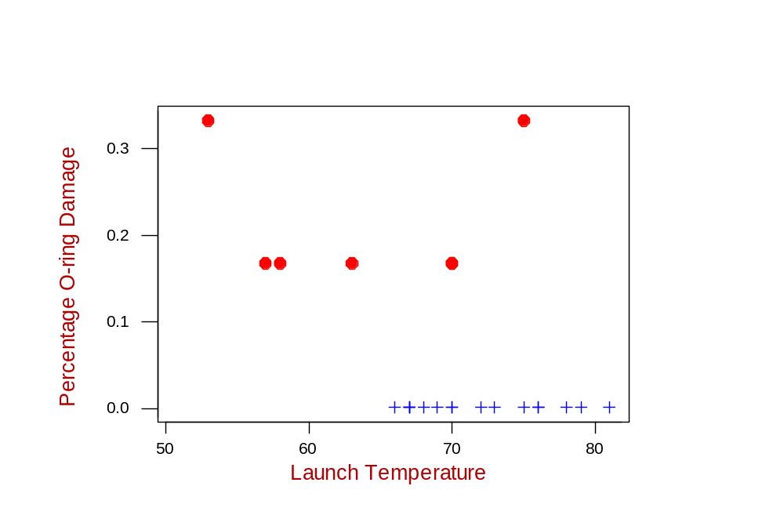
In any assessment of risk it is important to realise that there is information in the data where no damage occurred also.

Slide 28
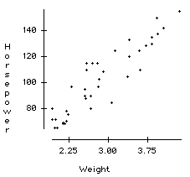
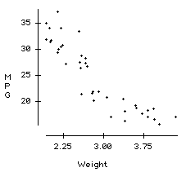
Measurements on 38 1978-79 model automobiles. Gas mileage in miles per gallon as measured by Consumers' Union on a test track. Other values as reported by automobile manufacturer. Source: Henderson and Velleman. (1981). Data originally collected from Consumer Reports.

Slide 29
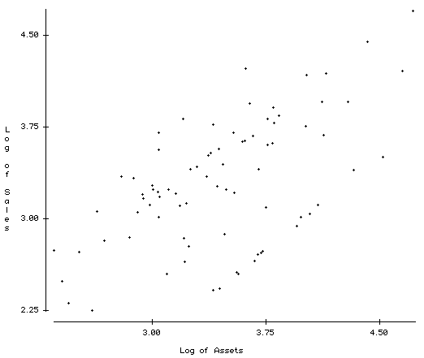
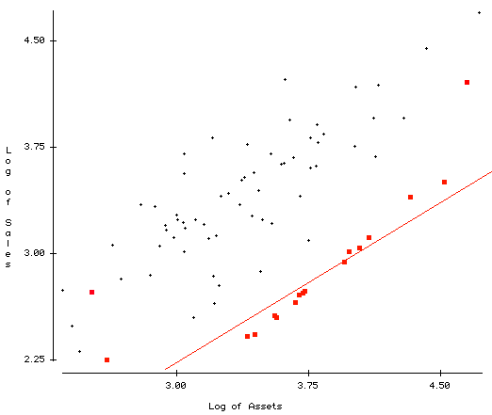
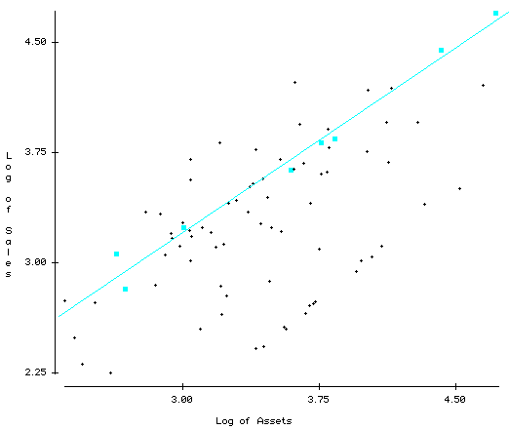
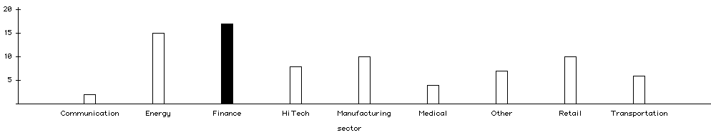
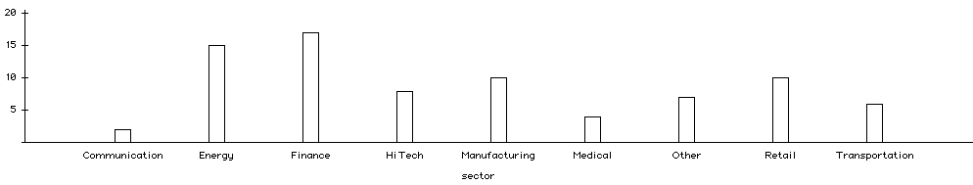
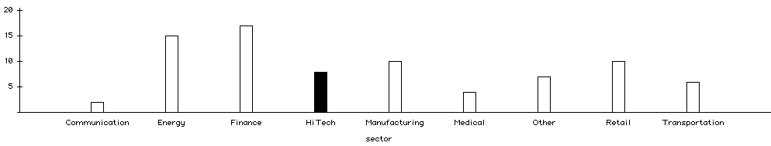
Companies in the HiTech sector show higher values for “Log of Sales” than would be predicted by “Log of Assets”
Companies in the financial sector show lower values for “Log of Sales” than would be predicted by “Log of Assets”

Slide 30
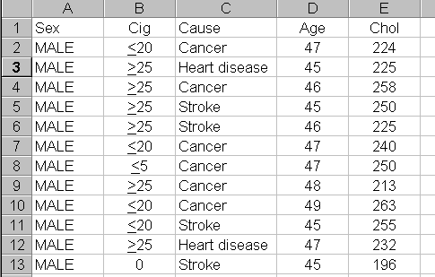
The cholesterol levels of 174 male and 120 female patients were measured. Also recorded was information regarding smoking habits, age, and the nature of their medical complaint.
For illustrative purposes, the first few cases are as follows...

Slide 31
SEX
  Qualitative (Categorical) Variable. Responses fall into categories Male/Fem. More specifically, we say that the measurement scale for these data is nominal.
CIG
  Qualitative (Categorical) Variable. Responses fall into categories Non-Smoker, Less than or equal to 5 a day, Less than or equal to 20 a day, More than 20 a day. Obviously these categories can be ordered, hence we say that the measurement scale for these data is ordinal.
CHOL
  Quantitative Variable. Response is a measurement reading on a continuous scale. Calculations such as 30 + 10 × 2 = 50 are possible. The measurement scale is Interval-Ratio.

Slide 32
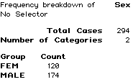
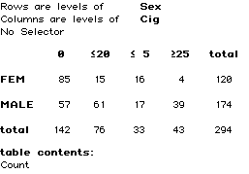
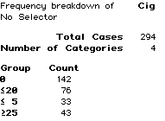
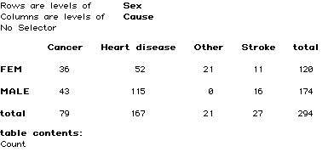
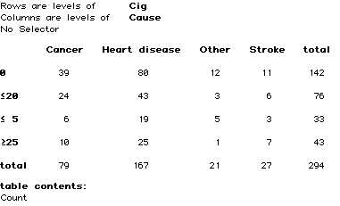
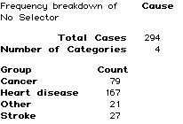

Slide 33
